Slide 1
Web Technology and DBMSs
An Introduction to Web Application Software to Intergrate DBMS

Slide 2
Software Architectures
“Architecture is defined as the fundamental organization of a system, embodied in its components, their relationships to each other and the environment, and the principles governing its design and evolution.”(IEEE Architecture Working Group, P1471, 1999)
Architectures describe software structure
  Components of software systems, their interfaces and relationships
  static as well as dynamic aspects
  blueprint of software system
Architectures connect software development phases
  requirements mapped iteratively to components and their relationships

Slide 3
Software Architectures cont’d
“Architecture is the set of design decisions that keeps its implementers and maintainers from exercising needless creativity.”(Desmond F. D’Souza and Alan C. Wills, 1999)
Architectures describe different viewpoints
  conceptual view: entities of application domain and their relationships
  process view: system runs, concurrency, synchronization
  implementation view: software artefacts (subsystems, components, source code)
  runtime view: components at runtime and their communication
Architectures make systems comprehensible and controllable
  structuring according to different viewpoints
  enables communication between different stakeholders

Slide 4
Developing Architectures - Influences on Architectures
Functional Requirements
  Clients
  Users
  Other Stakeholders
Architecture
Non-Functional Requirements
  Performance
  Scalability
  Reusability
  Other?

Slide 5
Developing Architectures - Influences on Architectures
Technical Aspects
Operating System
Middleware
Legacy Systems
Other?
Architecture
Experience with
Existing Architecture
Patterns
Project Management
Other?

Slide 6
Developing Architectures
Remember, requirements are always subject to change.
  Organizational & Environment changes
  Ambiguous requirements initially
Thus, iterative approaches are the suggested means of development
  Pro: Helps to mitigate design risks
  Caution: Doesn’t guarantee a good architecture (ex., What about legacy systems?)

Slide 7
Developing Architectures – Design Patterns
A general and reusable solution to a commonly occurring problem in the design of software
A template for how to solve a problem that has been used in many different situations
NOT a finished design
  the pattern must be adapted to the application
  cannot simply translate into code

Slide 8
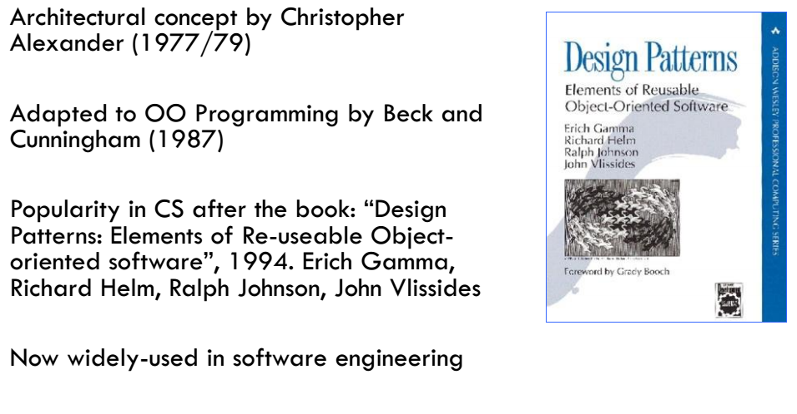
Origin of Design Patterns

Slide 9
The MVC Design Pattern Need
Design Problem:
Need to change the look-and-feel without changing the core/logic
Need to present data under different contexts (e.g., powerful desktop, web, mobile device).
Need to interact with/access data under different contexts (e.g., touch screen on a mobile device, keyboard on a computer)
Need to maintain multiple views of the same data (list, thumbnails, detailed, etc.)

Slide 10
The MVC Design Pattern cont’d
Design Solution:
Separate core functionality from the presentation and control logic that uses this functionality
Allow multiple views to share the same data model
Make supporting multiple clients easier to implement, test, and maintain

Slide 11
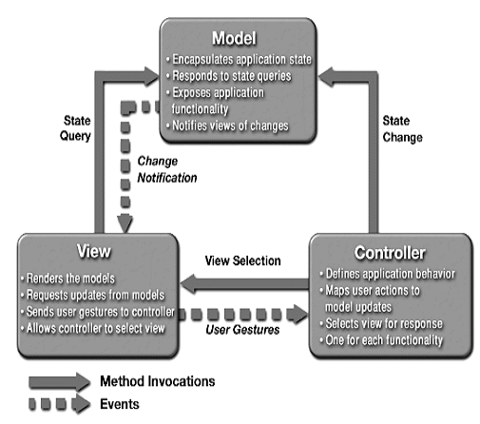
The Model-View-Controller Pattern
Design pattern for graphical
systems that promotes
separation between model
and view
With this pattern the logic
required for data maintenance
(database, text file) is separated
from how the data is viewed
(graph, numerical) and how
the data can be interacted
with (GUI, command line)

Slide 12
The Model-View-Controller Pattern
Model
manages the behavior and data of the application domain
responds to requests for information about its state (usually from the view)
follows instructions to change state (usually from the controller)
View
renders the model into a form suitable for interaction, typically a user interface (multiple views can exist for a single model for different purposes)
Controller
receives user input and initiates a response by making calls on model objects
accepts input from the user and instructs the model and viewport to perform actions based on that input

Slide 13
The MVC for Web Applications
Model
database tables (persistent data)
session information (current system state data)
rules governing transactions
View
(X)HTML
CSS style sheets
server -side templates
Controller
client-side scripting
http request processing
business logic/preprocessing

Slide 14
Developing Architectures - Frameworks
Frameworks: another option to reuse existing architecture
  something that provides you a frame to be filled!
Reuse of existing software objects that just need to be properly configured
Bound to a specific technology
  Require training
  High cost of switch
  Level of customization not always acceptable

Slide 15
Web APPLICATION Architectures: concerns
Layering Aspect
  “Separation of concerns”
  How many concurrent users are you serving?
  Shared needs among multiple applications? (e.g., security)
Data Aspect
  What kind(s) of data are you delivering?
    Structured vs. non-structured
    On-demand vs. real-time
  What are the bandwidth requirements?
    Size & nature of data
    Again, audience concerns

Slide 16
Architecture Types
Web Platform Architecture (WPA)
  Platform = Infrastructure
    Hardware
    Software modules & configurations
    Choice of software platform (e.g., J2EE, .NET)
Web Application Architecture (WAA)
  Conceptual view of how key business processes and needs are separated & implemented
  Often domain-specific
  Greater complexity requires greater modularity

Slide 17
Example of a WAA
Web Application
Presentation
Business Logic
Data Management
Personalization
Security
Search

Slide 18
Generic Web (Platform) Architecture
The Web “platform” is based on
  TCP/IP
  HTTP
  HTML
It’s essentially a Client/Server architecture!
  In term of patterns one of the simplest one
But still thing can get complex…
  Components on the network (firewall, proxy, load balancer)
  Components in the intranet (Web server, application server, database, legacy systems, web services)

Slide 19
Web Application Platform
A webapp platform is the host environment for application development and operation
The platform includes
  operating system, web server,
  language support, database support
Web
Application
Web
Server
Language
Support
Database
Support
platform
Operating System
Hardware

Slide 20
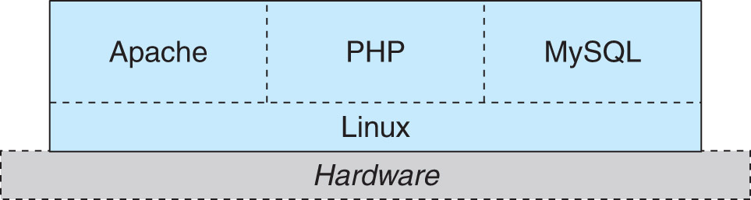
Webapp platform - LAMP /WAMP
Linux, Apache, MySQL, PHP/Perl/Python
The LAMP platform appeared in mid 1990's and has become very popular
LAMP is open-source free software, which is one reason for its popularity

Slide 21
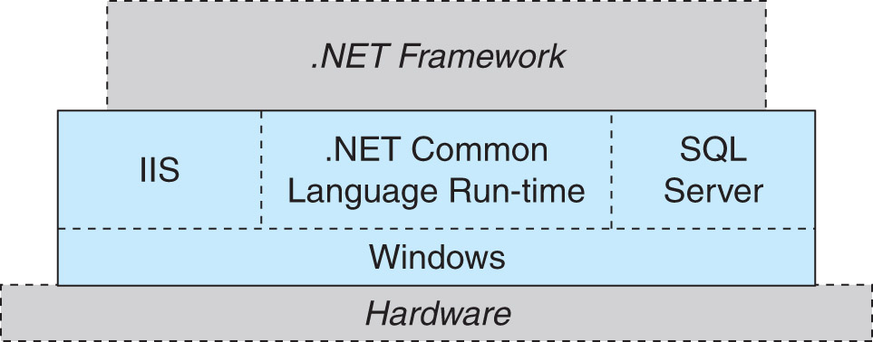
Webapp platform - Microsoft / .NET
All Microsoft products (licensed)
.NET supports multiple languages
Runs primarily on Windows Server O/S

Slide 22
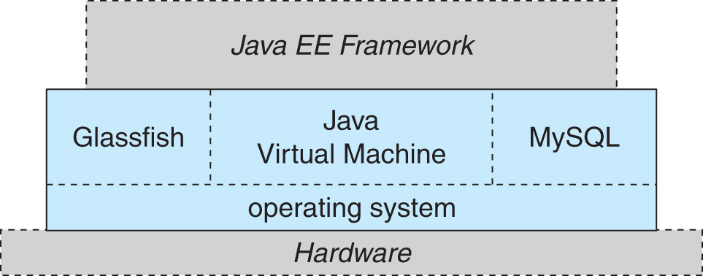
Webapp platform - Sun Microsystems/Java EE
Supports Java language development
Supported by multiple operating systems
Proprietary, free license

Slide 23
Web Application Framework
A webapp framework is a set of tools that support webapp development with:
  A standard design model (e.g., MVC)
  User interface toolkit
  Reusable components for common functions (authentication, e-commerce, etc.)
  Database support
  Support for distributed system integration

Slide 24
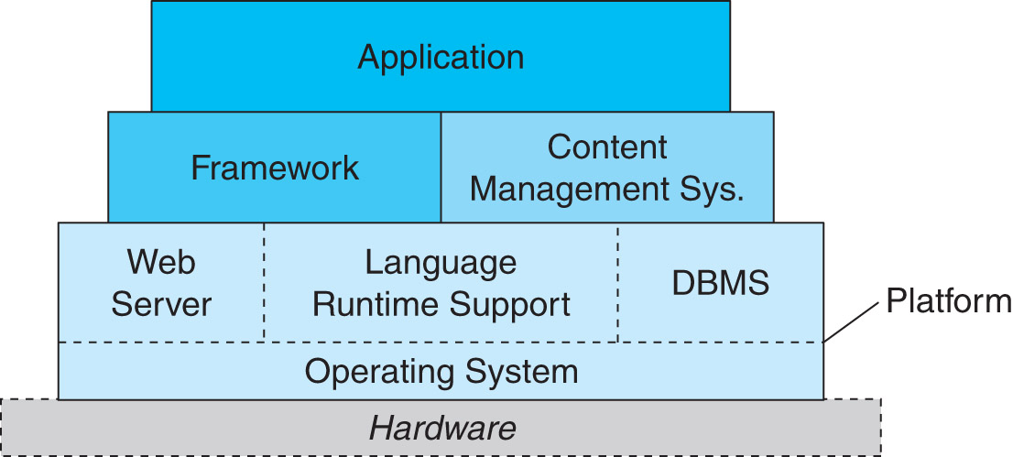
Web Application Framework
Frameworks give application developers more powerful building blocks to work with

Slide 25
Java EE
Java EE is based purely in the Java programming language
Includes
  Java Servlets
  Java Server Pages
  Java DataBase Connectivity
  Java Server Faces
  Enterprise Java Beans
  etc.

Slide 26
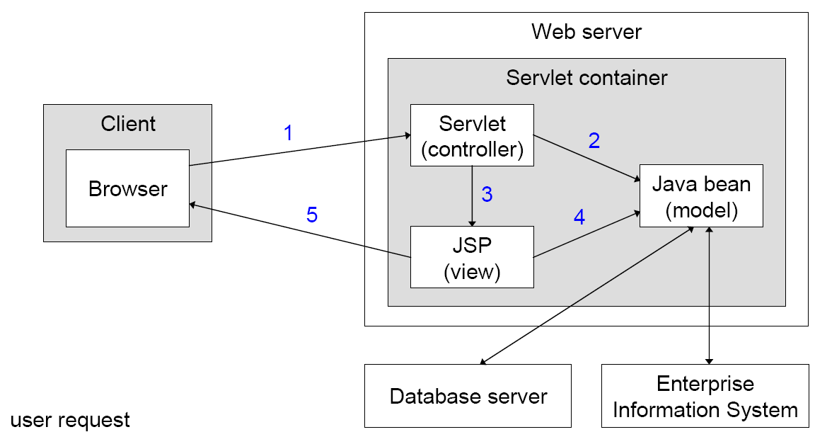
JSP-Model-2 Architecture
1. user request
2. create/change model
3. create/change view
4. generate output
5. server response

Slide 27
.NET Framework
.NET Framework is a Microsoft (licensed) product
.NET supports many programming languages through its Common Language Runtime (CLR) system
C#
ASP
VB
C++
etc.
compilation
CLR Intermediate Language
CLR Interpreter

Slide 28
Ruby On Rails
Ruby: a dynamically typed object-oriented programming language
Rails: a webapp framework, featuring:
  automatic code skeletons
  built-in testing features
  object-relation mapping
  default implementation of common webapp functions

Slide 29
Struts
A webapp framework based on Java EE
Features:
  use of MVC design paradigm
  Centralized XML-based application configuration that can define many functions
  Action definitions link user interface events to Controller and View modules

Slide 30
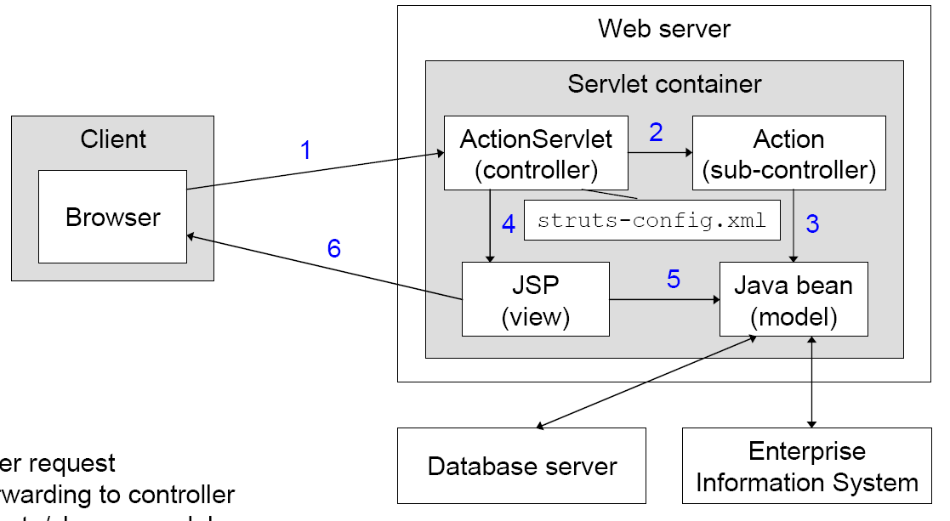
Struts Architecture
1. user request
2. forwarding to controller
3. create/change model
4. create/change view
5. generate output
6. server response

Slide 31
Content Management System
A CMS is a tool for creating, cataloging, and accessing documents (web pages)

Slide 32
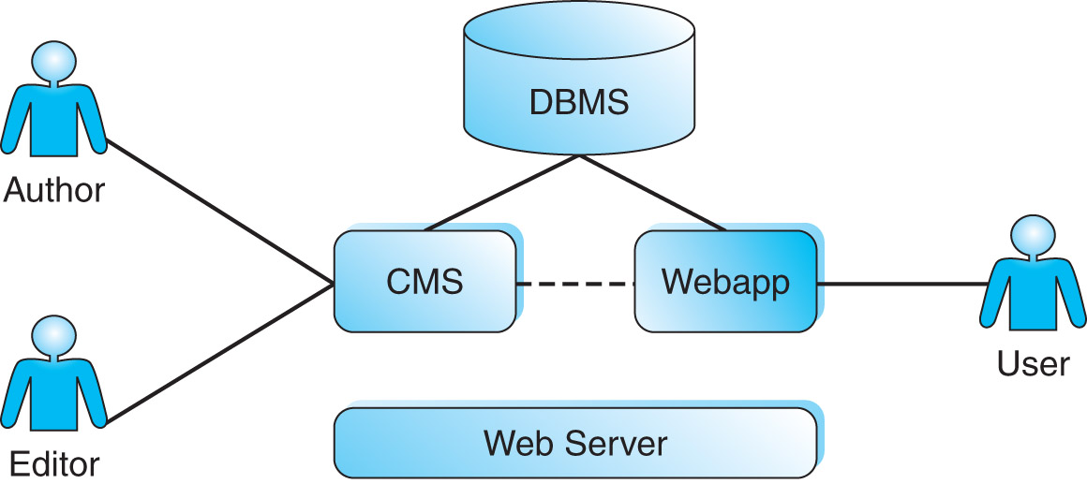
Content Management System
A CMS can streamline and automate the process of creating, approving, deploying, and retiring web content

Slide 33
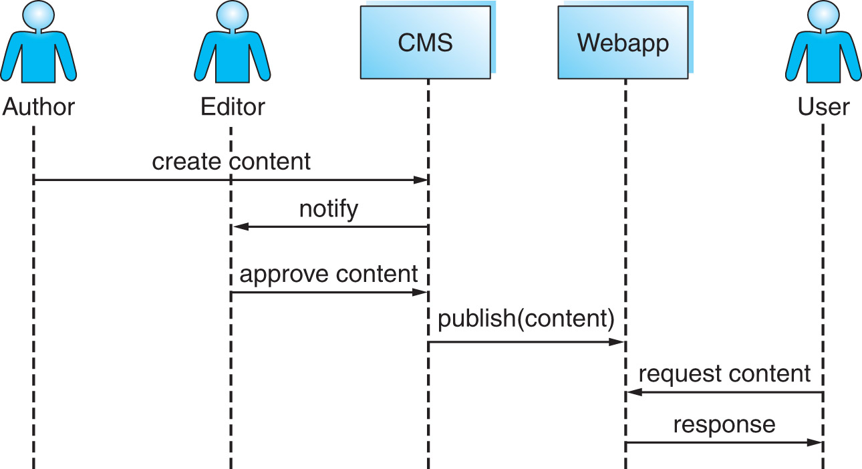
Workflow Management
A CMS can coordinate the steps involved in creating, editing, and approving web content within an organization

Slide 34
Building Web database Applications
Apply appropriate software engineering life cycle
  Requirements analysis
  Design – can use patterns and/or frameworks
  Implementation
  Testing
  Remarks:
Security of data is very important in Web Database applications
Use MySQL/DBMS privilege system to control access to data
User identification and personalization is necessary with web database applications

Slide 35
Web Server Software - New Technologies
There are many new technologies that allow access to DBMSs
Naturally there are advantages and disadvantages associated with each of them
Examples
  Microsoft IIS, ASP - JScript / VBScript
  Sun Microsystems Java - JSP, servlets
  Netscape LiveWire – Javascript
Most common combination (LAMP/WAMP)
  PHP code embedded in HTML
  To access MySQL databases

Slide 36
PHP & MySQL
Stands for PHP:Hypertext Preprocessor
  Recursive acronym
Is a scripting language
  Interpreted, not compiled
  Public domain software
Embedded directly into HTML pages
  Pages are published with .php extension
Server executes the embedded PHP code every time that page is requested
Home Page: www.php.net
PHP+MySQL is a very popular combination for producing dynamic web pages
MySQL - Public domain RDBMS
Home Page: www.mysql.com

Slide 37
Web Database Architecture with PHP and MySQL
1
2
3
Browser
Web Server
PHP Engine
MySQL Server
6
5
4
Browser issues an HTTP request for a particular web page
Web server receives the request, retrieves the file and passes it to the PHP engine for processing
PHP engine connects to the MySQL server and sends the query
MySQL server receives the query, processes it, and sends the results back to the PHP engine
PHP engine receives the results, prepares the HTML page and send it to the web server
Web server sends the HTML page to the browser and browser displays the page to the user

Slide 38
PHP+MySQL Programming Model
Web site made from “.php” files on web server
“.php” files contain HTML with embedded PHP code
PHP code is enclosed in <?php ... ?>
Basic steps followed in any PHP script used to access a database:
  Check and filter data coming from the user
  Set up a connection to MySQL server
  Selecting the appropriate database
  Query the database
  Retrieve the results
  Present the results back to the user
  Close the database connection

Slide 39
Sample PHP Code
<html>
<head>
<title>Sample Code</title>
</head>
<body>
……
<?php
$db = mysql_connect("localhost", "root");
mysql_select_db(“dreamhome",$db);
$result = mysql_query("SELECT * FROM staff",$db);
printf("First Name: %s<br>\n", mysql_result($result,0,"first"));
printf("Last Name: %s<br>\n", mysql_result($result,0,"last"));
printf("Address: %s<br>\n", mysql_result($result,0,"address"));
printf("Position: %s<br>\n", mysql_result($result,0,"position"));
?>
….
</body>
</html>

Slide 40
Summary
Organizations increasingly want data to be available over the internet
Web databases require new technologies to extend simple HTTP protocol used on the web
PHP is a scripting language embedded in html code to develop web database applications
Security is one of the main issues in web database applications
Useful Links
  www.w3.org – World Wide Web Consortium
  www.wdvl.com – Web Developer’s Virtual Library
  www.php.net – PHP home page
  www.mysql.com – mysql home page

Slide 41
Content Management Systems
Joomla!
  open source, free
  based on MySQL and PHP
  supports web pages, RSS feeds, blogs, etc.
Vignette
  proprietary product
  includes extensive workflow management support
  integrates with related development tools

Slide 42
Web Application Software Stack
The webapp software stack includes platform, framework, CMS, and application

Slide 43
Review
MVC pattern
Webapp Platforms
  LAMP, Microsoft/.NET Sun/Java
Webapp Frameworks
  Java EE, .NET Framework, Ruby on Rails, Struts
Content Management Systems
  Joomla!, Vignette
Webapp Software Stack

